Slide 1
Lecture 5: Computer Arithmetic
To watch lecture video click link below
Lecture 5a video
To view slides, continue to next slide

Slide 2
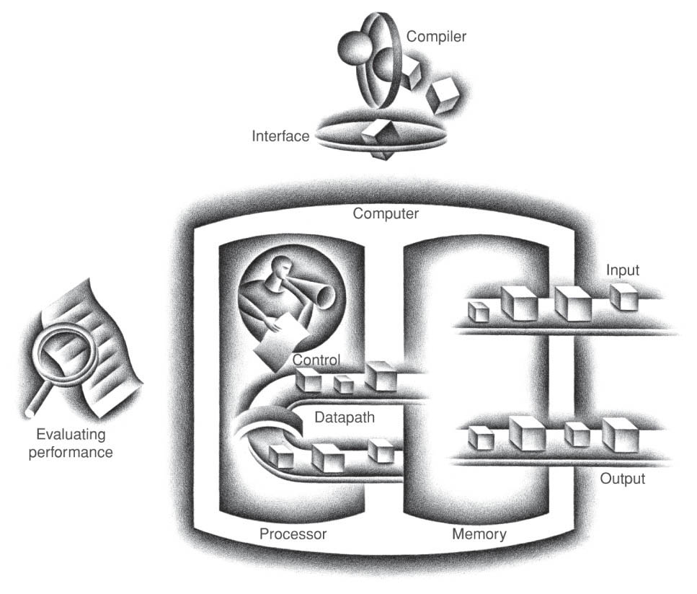
Lecture 5: Computer Arithmetic Integer Operations
This lecture covers basic components of Processor Datapath

Slide 3
Lecture 5a: ALU
Implementation of Integer Operations add, sub, and, or
Module 5 figure credit: Computer organization and design : the hardware/software interface
Textbook by David A Patterson John L Hennessy and John L. Hennessy

Slide 4
MIPS Instructions
add Rd, Rs, Rt
sub Rd, Rs, Rt
and Rd, Rs, Rt
or Rd, Rs, Rt
Operands:
two 32-bit integer data in 2’s complement (stored in Rs and Rt)
Result:
32-bit integer data in 2’s complement (to be stored in Rd)
What hardware unit(s) to perform these four (add, sub, and, or) operations?

Slide 5
Logic Design
Hardware building blocks
AND gate, OR gate, Invert, Multiplexer
We had a quick review of these components in Module 4
Building up Basic Circuits
1-bit adder (1-bit unit with add functionality only)
1-bit ALU (w/ and, or, add functionalities)
1-bit ALU (w/ and, or, add, sub functionalities)
32-bit ALU

Slide 6
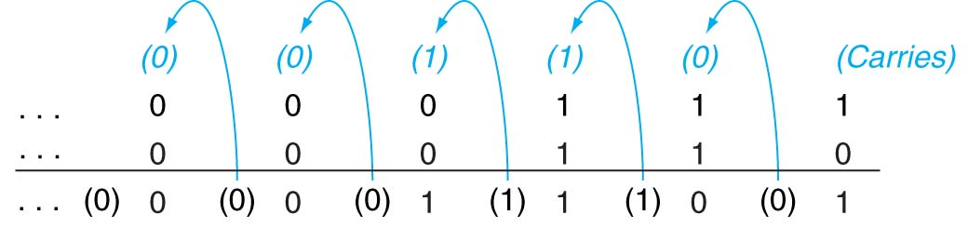
Binary Addition with Carries

Slide 7
1-bit Adder
a | b | CarryIn | sum | CarryOut
0 | 0 | 0 | 0 | 0
0 | 0 | 1 | 1 | 0
0 | 1 | 0 | 1 | 0
0 | 1 | 1 | 0 | 1
1 | 0 | 0 | 1 | 0
1 | 0 | 1 | 0 | 1
1 | 1 | 0 | 0 | 1
1 | 1 | 1 | 1 | 1
1-bit adder block diagram
Note: the block diagram represents the functionality displayed in the truth table. In this class we will use block diagrams to represent hardware units. Detailed circuit design could be found in zyBook 8.5.
Truth table

Slide 8
1-bit ALU with 3 Operations
ALU: Arithmetic Logic Unit.
Operations supported in this 1-bit ALU: and, or, add
Control of this unit
The ALU has the functionality of multiple operations;
However, at any specific time, only one operation is in action;
Control signals: to decide which operation to perform
In this Design: a 2-bit control signal named Operation, or simply op.
Op | Action
00 | and
01 | or
10 | add

Slide 9
1-bit ALU with 3 Operations
multiplexor
Operation Principle of this unit
The AND gate, OR gate, and 1-bit adder operates simultaneously for any inputs
The Multiplexor controls which output should be taken as the Result.
Result = a and b if Operation is 00
Result = a or b if Operation is 01
Result = a + b if Operation is 10
Op | Action
00 | and
01 | or
10 | add

Slide 10
Subtraction
How to perform sub operation?
a - b ⬄ a + (-b)
In 2’s complement, from b to (-b) we invert every bit of b and add 1.
So, we need to invert (add an inverter) and add 1 (use CarryIn)
a + b: set CarryIn to be 0
a - b: set CarryIn to be 1 & invert b as input
Additional control signal: binvert
binvert = 0 for and, or, add
binvert = 1 for sub

Slide 11
A 1-bit ALU with 4 Operations and, or, add, sub
Binvert | Op | Functionality
0 | 00 | and
0 | 01 | or
0 | 10 | add
1 | 10 | sub
Note: CarryIn will be 1 for sub, but see next slide for details about CarryIn value.

Slide 12
Building a 32-bit ALU
We connected 32 1-bit ALU into a 32-bit ALU.
The control signal
(Operation) will be the same for all 32 1-bit units.
The CarryIn for ALU₀ will be 1 for sub and 0 for and, or, add.

Slide 13
32-bit ALU Block Diagram
We have built up a 32-bit ALU with and, or, add, sub operations
To further abstract out hardware details, we use the following block diagram to represent a 32-bit ALU
operation
operation | Action
000 | and
001 | or
010 | add
110 | sub
a
32
ALU
result
32
b
Here, the operation control signal is 3-bit that combines 1-bit Binvert and previous 2-bit operation signals.
32

Slide 14
Detecting Overflow
No overflow
for logical operations (and, or)
when adding a positive and a negative number
when signs are the same for subtraction
Overflow occurs when the value affects the sign:
when adding two positives yields a negative
or, adding two negatives gives a positive
or, subtract a negative from a positive and get a negative
or, subtract a positive from a negative and get a positive
Thinking question: Consider the operations A + B, and A – B
Possible overflow if B is 0 ?
Possible overflow if A is 0 ?

Slide 15
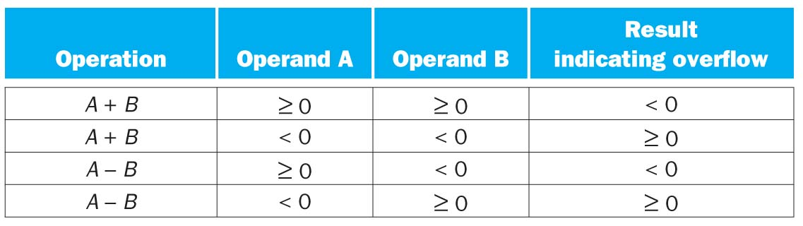
Overflow for Addition and Subtraction

Slide 16
Effects of Overflow
An exception (interrupt) occurs
Control jumps to predefined address for exception
Interrupted address is saved for possible resumption
Details based on software system / language
example: flight control vs. homework assignment
Don't always want to detect overflow — new MIPS instructions, e.g.
addu, addiu, subu (for unsigned operations)
Details omitted in this course.

Slide 17
Summary and To-Do List
Hardware units for arithmetic logic operations
and, or, add, sub
Focused on block diagram (abstraction)
know the functionality of the units
understand the role of control signals
To Do:
zyBook 3.1, 3.2, 8.5 (8.5 just read, no exercise.)

